Slide 1


Slide 2

Introducing PAGEMAP_SCAN IOCTL for Windows syscalls translation and CRIU
Muhammad Usama Anjum
Collabora
Andrei Vagin
CRIU

Slide 3
GetWriteWatch() and ResetWriteWatch() Windows APIs
Get and/or Reset the write tracking state
Operation on any size of memory area
Returns after finding X dirty pages from total of N pages (X < N)
API is relatively widely used on Windows
Implementing copy-on-write mechanisms
Security, intrusion and debugger detection
Garbage collectors

Slide 4
Translation by mprotect() + SIGSEGV or Userfaultfd() in Userspace
Traveling of signals or messages between kernel and userspace
Too much slow to be useful in high performance demanding applications like games
Doesn’t fulfill all the use cases
Write protected memory isn’t desired by some software layers like Vulkan drivers

Slide 5
Soft-Dirty PTE flag and Soft-Dirty VMA flag
Soft-dirty flag is a combination of PTE and VMA flag
If any of these two flags are set, the page is soft-dirty.
Possible operations
Read soft-dirty flags of desired pages from pagemap file
Clear soft-dirty flags from all the PTEs of the process

Slide 6
Kernel’s Internal Activity Affecting Soft-Dirty Flag
VMAs having the different VMA soft-dirty flags are merged
This makes non-softdirty VMA soft-dirty
If they aren’t merged, there is possibility that the maximum vma limit is reached (/proc/sys/vm/max_map_count).

Slide 7
Shortcomings of Soft-Dirty Flag
It is not accurate
Atomic get and clear operation isn’t possible
Soft-Dirty flag on a part of memory region cannot be cleared

Slide 8
CRIU uses Soft-Dirty Flag
CRIU freezes processes to pre-dump their memory
CRIU doesn’t have the accurate information about pages to the moment of dumping them
CRIU struggles to handle huge sparse mappings

Slide 9
Add Prototype IOCTL based on Soft-Dirty Flag
Implement atomic GET+CLEAR operation
Implement Clear operation on a region of memory
Optionally ignore Soft-Dirty flag on VMA
The prototype got broken by upstream change:
The mprotect() stopped setting the Soft-dirty PTE flag when VMA Soft-dirty flag was set
The users weren’t affected by this patch, only prototype was
Add a linked list in struct VMA struct to keep track of soft-dirty VMA parts, but will increase the memory usage

Slide 10
WP Asynchronous feature in Userfaultfd and base IOCTL on it
Userfaultfd uses _PAGE_UFFD_WP PTE flag to Write-Protect the page
Add Asynchronous WP mode in Userfaultfd UFFD_FEATURE_WP_ASYNC
Resolve the Page Fault from kernel instead
A page is considered dirty (written) if it isn’t write protected
Dirty = !(is_wp(page))

Slide 11
UFFD_FEATURE_WP_UNPOPULATED for Userfaultfd
Write protection on empty pages isn’t recorded
Add UFFD_FEATURE_WP_UNPOPULATED to remember the write-protection for empty pages by using PTE Markers

Slide 12
PAGEMAP_SCAN IOCTL
Generic IOCTL to scan the page flags
Use userfaultfd WP flag in place of soft-dirty flag
The input of IOCTL is given in struct pm_scan_arg
Return compacted data to user in form of ranges
Optionally max_pages to find can be specified
The scan ending address is returned in walk_end
Implement the scanning for all memory types:
Pages, Huge Pages, HugeTLB and Holes

Slide 13
Supported operations
Get operation is always performed when output buffer is specified
PM_SCAN_WP_MATCHING write protects the pages of interest.
PM_SCAN_CHECK_WPASYNC aborts the operation if non-Async WP pages are found

Slide 14
Filtering support
category_inverted: PAGE_IS_* categories which values match if 0 instead of 1
category_mask: Skip pages for which any category doesn't match
category_anyof_mask: Skip pages for which no category matches
return_mask: PAGE_IS_* categories that are to be reported in page_region

Slide 15
Supported flags
PAGE_IS_WPALLOWED: Page has async-write-protection enabled
PAGE_IS_WRITTEN: Page has been written-to
PAGE_IS_FILE: Page is file backed
PAGE_IS_PRESENT: Page is present in the memory
PAGE_IS_SWAPPED: Page is in swapped
PAGE_IS_PFNZERO: Page has zero PFN
PAGE_IS_HUGE: Page is THP or Hugetlb backed
PAGE_IS_SOFT_DIRTY: Page is soft-dirty (WIP)

Slide 16
Performance Improvements
There were multiple passes to make code more simpler and more performant
Reduce the internal temporary usage to 12 kB as data cannot be copied to user buffer from inside the mm lock
Reduce the number of iterations of page walks
WP the pages and flush TLB only once

Slide 17
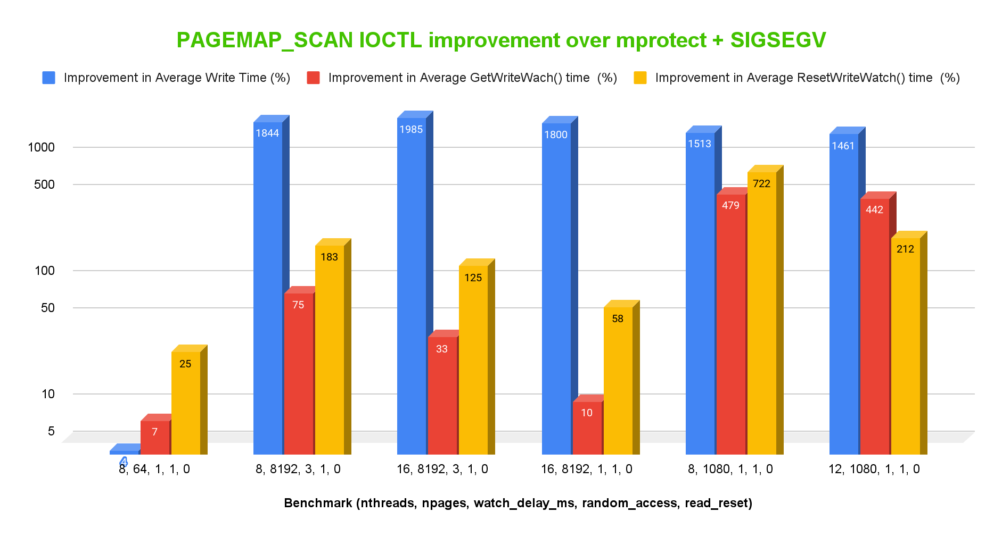
Benchmark

Slide 18
PAGEMAP_SCAN in CRIU
Performance improvements
Don't need to revise unneeded pages
Batch-mode processing of target pages
New possibilities for CRIU in unprivileged mode
Detect zero pages
Physican addresses in /proc/pid/pagemap have been hidden to mitigate the rowhammer bug.
Track memory change

Slide 19
More Use Cases?

Slide 20
Many Thanks-to
Andrei Vagin
Andrew Morton
Michał Mirosław
Paul Gofman
Peter Xu
Et al.

Slide 21
Thanks

Slide 22
Question?

Slide 23


